Slide 1
Havana Syndrome/ AHI Concerns In Our Nation
By KEN STROUD

Slide 2
Havana Syndrome/Non- Kinetic Brain Injury (NKBI)/ Anomalous Heath Incidents (AHI)
What is Havana Syndrome?
  Per Google AI “Havana Syndrome" refers to a mysterious set of health issues, including neurological and sensory symptoms, that have affected U.S. diplomats and other government personnel, initially in Cuba, and later in other locations.
  First diagnosed in 2016 by Dr. Michael Ellis Hoffer from the University of Miami - From my experience, he only diagnosis intelligence, federal, state, and military.
  No longer associated with government personnel only - Civilians are affected
EMF/ Directed Energy Weapon based attacks from wireless sources, such as radio frequency and microwave, to the brain, body, and nervous system are commonly associated. High levels of volts per meter seem to also be a part of some targeting
V2K in many cases is a subset attack of Havana Syndrome – Voices from V2K operators or AI that mimic the patient has a schizophrenic like condition

Slide 3
Emotional and Physical Components of Targeting
What is it like emotionally to be affected by Havana Syndrome
  Confusion – Constant V2K Chatter for many
  Depression – Feeling it will never end
  Loss of reputation - Sanity questioned – Job loss due to not being able to concentrate from V2k and/ or pain attacks.
  Alcohol or substance abuse may be associated – Slow decay of the individual due to self harm from the constant suffering - cravings can even be artificially enhanced by wireless neurological approach
  May lead to loss of properly
  May lead to suicide
    Some have called this form of suicide, artificial or coerced suicide, since the person is being pushed into the act by pain attacks/ subliminal thought placement/ V2K
What physical symptoms do many neuro attacked individuals experience daily or intermittently
  No silence – constant V2K chatter and/ or tinnitus for a large percentage of victims
  Pain Attacks and other nervous system effects
  Subliminal attacks
  Image attacks
  Sleep Depravation
  Physical damage to brain and body from EMF exposure
  Electronic Rape
  Forced or withheld bowel movements

Slide 4
V2K, RNM, and Wireless Neurological Approach
V2k- Also known as the microwave auditory effect, or Frey effect, was first described by neuroscientist Allan H. Frey in the 1961. The effect of V2k works when pulsed microwave radiation rapidly heats brain tissue, causing a thermoelastic expansion that generates a pressure wave. This wave travels through the skull to the inner ear, where it is interpreted as sound
RNM –Remote Neural Monitoring, as the name suggests, is a wireless technology that can be used to remotely monitor neural activity of a host
  The "voice of God" weapon: In 2007, The Washington Post reported that the Pentagon had pursued a weapon based on the microwave auditory effect that could beam voices into people's minds.
US Patent for V2K
  US 6470214 V2k 13-Dec-96 22-Oct-02 James P. O'Loughlin, Diana L. Loree United States Air Force Remotely transmits intelligible subjective sound into target consciousness. ("Voice to Skull")
  US 3393279 V2K 13-Mar-62 16-Jul-68 G.P. Flanagan Listening Incorporated Allows information to be remotely conveyed to subject via electromagnetic waves.
Possible Criminal Applications of V2k/ Wireless Neurological Approach
  Unauthorized human testing - Medical or technological advancement
  Harassment – Constant abuse through wireless technology to the brain/ body can constitute as electronic harassment
  Neural Piracy – Collection of data from neurological approach
  Coerced Suicide – Pushed into self harm from suffering/ constant badgering of Electronic Torture
  Battery – This charge is used for the unauthorized implant of technology in individuals
  Surveillance Without a Warrant – Section 702 of the Foreign Intelligence Surveillance act is set to expire March 2027
  Treson/ Espionage/ Domestic Terrorism – Leaders or civilians of our nation could be affected by subliminal/implanted thought or V2k
  Torture - Directed energy weapons or neuro-weapons used to inflict psychological trauma are widely recognized by international legal frameworks as patterns of torture.
  Rape/ molestation – Individuals affected by AHI’s commonly complain of effects similar to being raped/ molested

Slide 5
Forensic and Medical Testing For Wireless Neurological Technology Abuse that can lead to Havana Syndrome
Forensic Evidence – People that may be able to assist
  Amy Holum – Subliminal Acoustic Fingerprinting/ SAF - IR imaging- Audacity software
  Jesse Beltran – Implant/ RF/ Frequency readings from the body/ Non- Linear Junction Tests
  John Kingston - Implant/ RF/ Frequency readings from the body/ Non- Linear Junction Tests
  EMF Reader/ Signal Analyzers - Units can pick up high levels of Milliwatts per Square (mW/m2) also knows as Radio Frequency (RF), Volts per Meter (V/M) also know as Electrical Frequencies, and Milligauss (MG). All carry radiation. These conditions are commonly associated with individuals that are Targeted
Medical Evidence
  MRI
  CT Scans
  Ultrasound
  EEG – Long and Short
  Videonystagmography (VNG)
  Nerve Conduction Testing
  Vestibular Testing
  Blood Tests to include check for heavy metals in the blood
  Dr. Lydia Shajenko in New Jersey for medical diagnosis of civilians
  Dr Michael Ellis Hoffer in Florida for government and intelligence diagnosis
  Defense Health Agency (DHA) or DoW Warfighter Brain Health facility for military

Slide 6
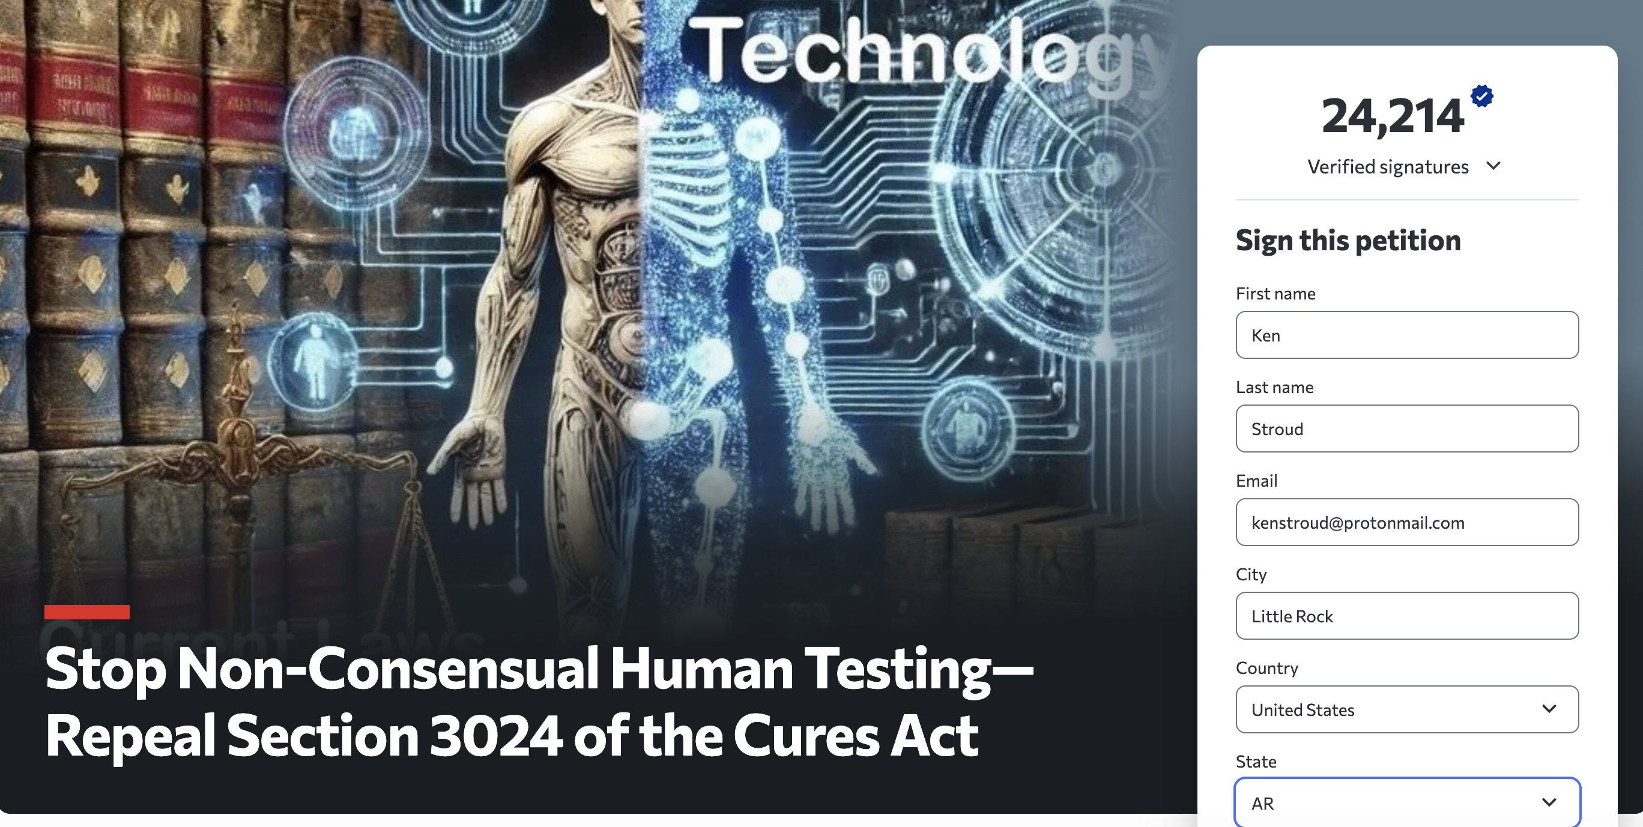
How the Cures Act Affects Unauthorized Medical Testing – Change.org Petition
The 21st Century Cures Act, according to the American Medical Association, promotes data sharing and access to electronic health information (EHI) to improve patient care and accelerate medical research. However, the issue of wireless neural data testing without consent presents a complex challenge that involves balancing the Cures Act's objectives with fundamental principles of human subject protection and individual privacy.
Informed consent is a cornerstone of ethical research, particularly when dealing with sensitive information like neural data. The Cures Act acknowledges the importance of obtaining consent for research involving human subjects. However, it also allows for waiver or alteration of informed consent for certain minimal risk clinical investigations, under specific conditions approved by an Institutional Review Board (IRB).
Neural data is highly sensitive and reveals intimate information about an individual's health, mental states, emotions, and cognitive functioning. This raises heightened privacy concerns regarding its collection and use.

Slide 7
How Could the Patriot Act - Section 702 – Allow Wireless Neurotechnology Based Covert Surveillance
The PATRIOT Act itself does not directly address or authorize the covert surveillance of individuals using neurotechnology, such as brain activity monitoring.
However, some aspects of the Act, which were written before the widespread development of current neurotechnology, have raised concerns about potential future applications to such surveillance:
Expanding the scope of surveillance: The PATRIOT Act broadened the definition of what constitutes "foreign intelligence information" and relaxed restrictions on surveillance, particularly under the Foreign Intelligence Surveillance Act (FISA) – Section 702. This expansion of surveillance powers could potentially be interpreted to include accessing and analyzing neural data if it were deemed relevant to national security investigations.
Adapting laws to new technologies: A key goal of the Patriot Act was to update surveillance laws to account for evolving technologies. If courts were to interpret neural data as a form of ”wireless electronic communication" or "information" covered by the Act's provisions, it could theoretically open the door to such surveillance.
Potential for broad data collection: The Patriot Act expanded the government's ability to obtain business records and other data held by third parties, such as internet service providers. As neurotechnology develops, there's concern that similar broad data collection powers could be applied to neural data, potentially without individuals' awareness or consent.
Key points to consider
Lack of explicit authorization: The PATRIOT Act does not specifically authorize or address the use of neurotechnology for covert surveillance. This includes the use of V2k and RNM or other wireless forms of neurotechnology
Concerns about broad interpretations: Some fear that the broad language of the Patriot Act and its adaptation to new technologies could be interpreted to justify future neurotechnology surveillance efforts.
Ongoing debates and developments: The use of neurotechnology, particularly in non-medical contexts, raises significant human rights and privacy concerns. These debates will likely continue to evolve as technology advances and legal frameworks are considered to address these issues.
  Section 702 (FISA) is now set to expire in March 2027 – This should push law enforcement to have a warrant for most surveillance – to include wireless neurological surveillance – if wireless neurological surveillance technology is being used.

Slide 8
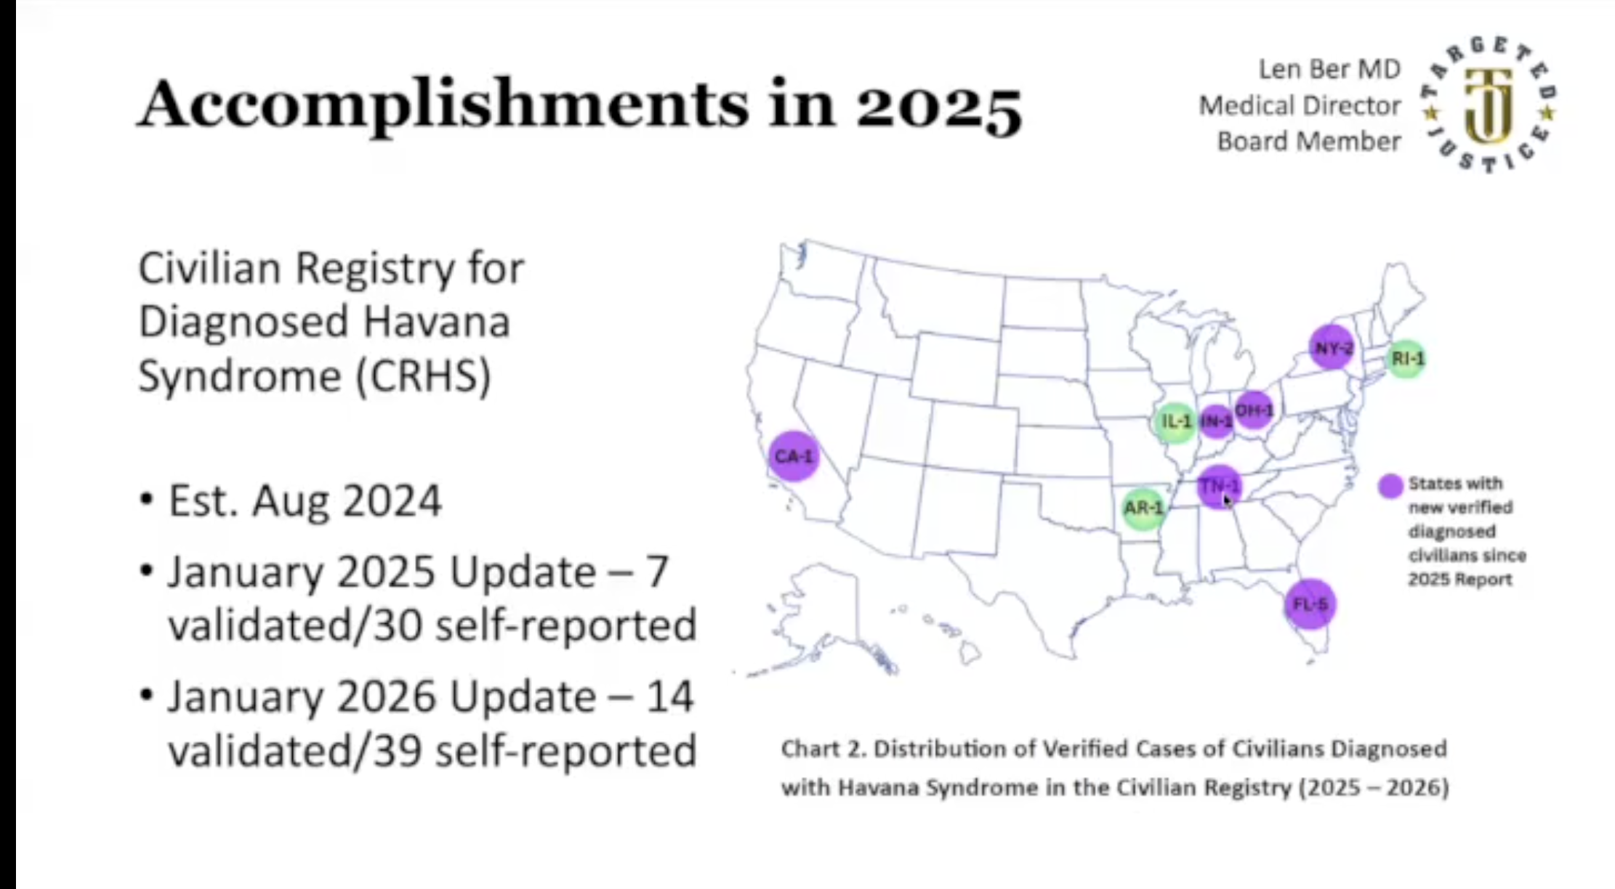
Medical Director, Dr. Len Ber’s Havana Syndrome Civilian Database Map
https://lenbermd.substack.com/p/dr-len-ber-reports-accomplishments?r=551y47&utm_campaign=post&utm_medium=web&triedRedirect=true

Slide 9
BER vs. CDC
Civilians Sue CDC and NIH in Landmark Lawsuit “BER v. CDC”: Demand Equal Diagnostic Guidance and Care for Havana Syndrome/AHI Victims on U.S. Soil
Quoted from Dr. Len Ber’s Substack article (link below)
TAMPA, Fla. – July 1 , 2026 – Seven individual civilian plaintiffs together with Targeted Justice, Inc., a 501(c)(3) nonprofit representing civilian victims of Anomalous Health Incidents (AHI), also known as Havana Syndrome, filed a federal lawsuit under the Administrative Procedure Act (APA) in the U.S. District Court for the Middle District of Florida against the Centers for Disease Control and Prevention (CDC), the National Institutes of Health (NIH), and Jay Bhattacharya, M.D., in his official capacity as Director of NIH and Acting Director of CDC.
The complaint filed on June 23, 2026 (case number 8:26-cv-01822-KKK-LSG) alleges that the agencies have unlawfully withheld and unreasonably delayed their mandatory public-health duties by refusing to recognize, surveil, or issue diagnostic guidance and care protocols for civilians diagnosed with AHI/Havana Syndrome on U.S. soil—despite having done so for federal employees and their families for years. Plaintiffs seek declaratory and injunctive relief compelling the agencies to fulfill their statutory obligations under the APA.
https://lenbermd.substack.com/p/civilians-sue-cdc-and-nih-in-landmark

Slide 10
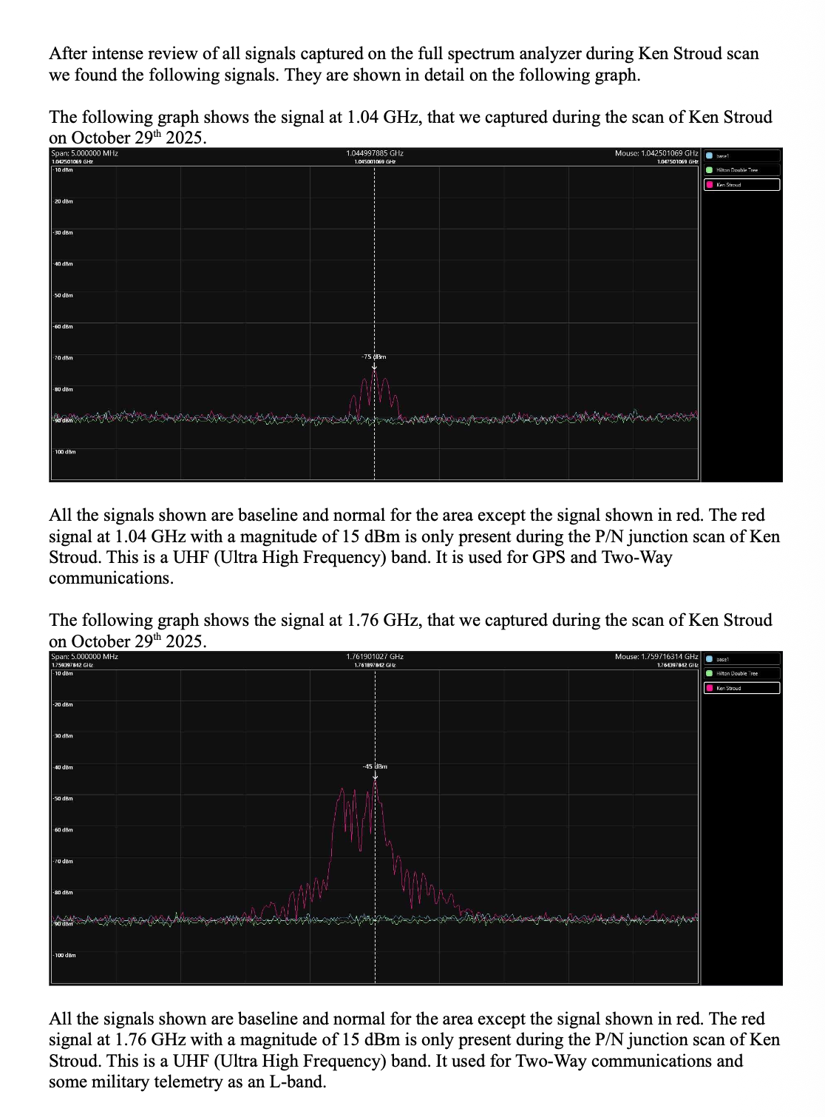
RF Engineer John Kinston’s
analysis showing Ultra High
frequencies coming from my
body/brain that are normally used for GPS and Two-Way
communication and some
military telemetry as an L-Band. Humans should not put off frequencies of this sort.

Slide 11
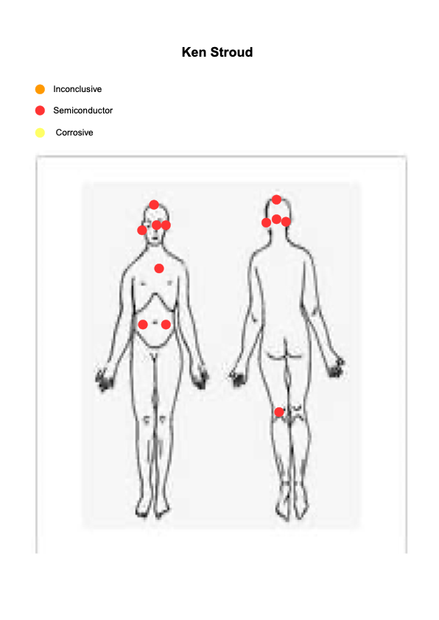
AAA Security/ John Kingston’s Report Continued
All Procedures were performed and conducted in accordance with the National Standards as set
forth and taught by the equipment manufacture. All Engineers and Representatives of AAA that
were involved with the procedures are trained and certified on the equipment used and procedures
conducted.
Various power settings were used on the Non-Linear Junction Detector equipment during the scan at
different depths and levels. After multiple passes are equipment indicated the following at the listed
value:
Location Semiconductor
Top of Head 25%
Just Below Right Ear 30%
Left Ear 30%
Behind Left Eye 20%
Heart Area 32%
Right Lower Abdomen 10%
Left Lower Abdomen 20%
Brain Stem 35%
Back Of Left Knee 30%

Slide 12
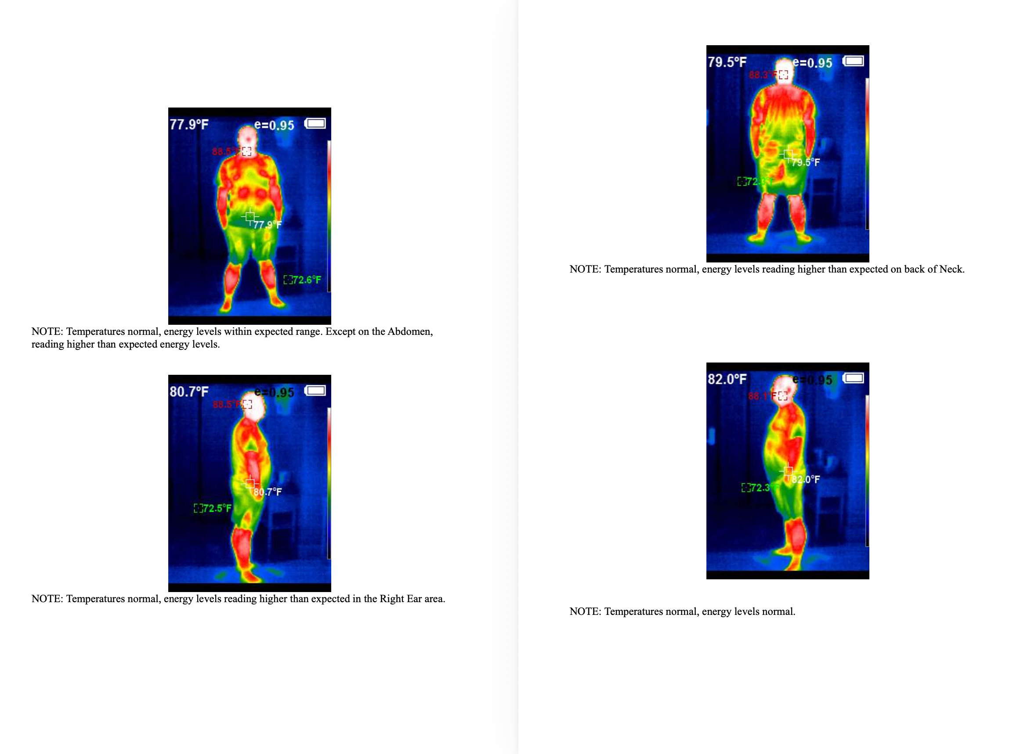

Slide 13
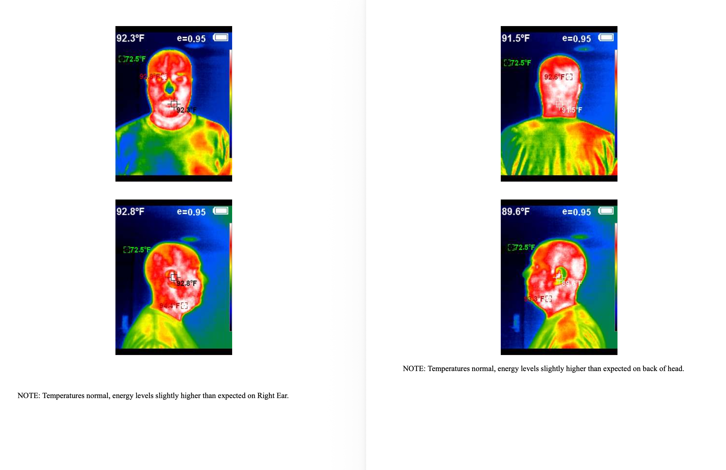

Slide 14
Conclusion – Recommendations for the State of Arkansas
Clearly defined diagnosis and treatment options for Havana Syndrome/ AHI’s in Arkansas, as hundreds, if not thousands, are making claims to be affected nationwide
Support structure for those affected by AHI’s/ Havana Syndrome
Investigations into criminal activity using wireless neurological technology – process for law enforcement to follow that assists those affected by AHI’s/ Havana Syndrome – This is not currently happening in relation to my own situation/ or for many others I have communicated with
Awareness of wireless neurological technology and how it can affect the public
Disability options available for those affected by Havana Syndrome/ AHI’s
Laws built to protect against Neural Piracy and Electronic Torture that can lead to Havana Syndrome
Tracking system for those that make claims of experiencing AHI’s to gain an understanding of how many may be affected

